Slide 1

The Forgotten Song
The untold story of those around us

Slide 2
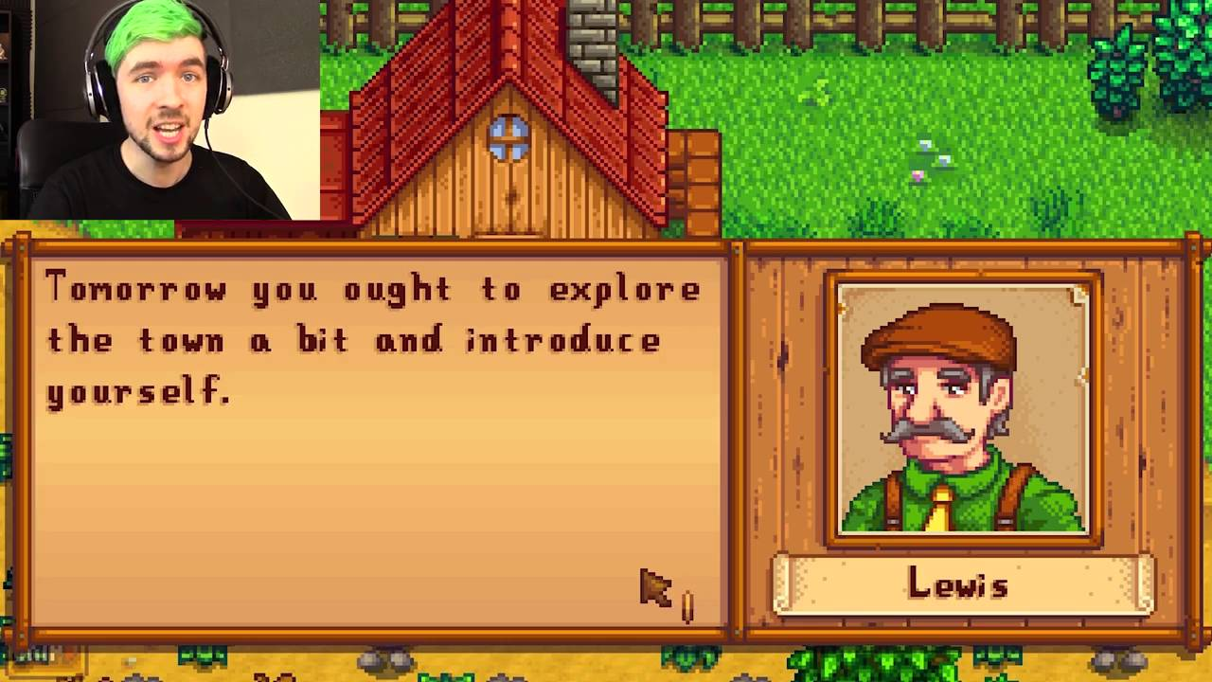
Purpose
In today’s world we associate with a multitude of people who are an ordinary part of our daily lives. We pass them by without ever learning who they are; their achievements, their struggles, their needs; and our capacity to learn from them, or help them. The purpose of The Forgotten Song is to provide a catalyst for the player to learn to empathize with all kinds of people. The message of this game is that everyone matters.

Slide 3


Slide 4
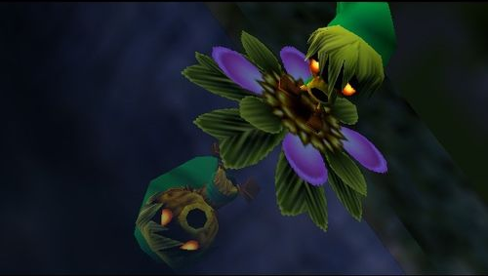
Concept
In The Forgotten Song (Tentative Title) you have the opportunity to play through the eyes of the NPC’s. It is through their eyes, and their experiences that you learn about the fantastic world you find yourself in, and how each individual can influence the life of the other.

Slide 5
Vision
Imagine you find yourself in a world of fantasy and wonder. You are passign through a small country province. The people of the land seem happy and full of love! However it isn’t long before you realize the deep scars that stripe the hearts of these seemingly happy people. At best, they pretend that everything is fine and happy, choosing to ignore their problems rather than find a solution. At worst they harbor grudges, or try to discretely bring chaos and pain to those whom they envy and hate. Little do they realize that their enmity is bringing destruction to the entire land. What is to be done? After all, it’s not your problem… or is it?
After a brief stay you wake up to be on your way; but nothing is familiar anymore. You have awakened somewhere else in the province. You ARE someone else! You become a stranger to yourself, and familiar to these strangers! You hardly have time to adjust to this new life before you wake up one morning and it’s happened again! You are seeing the world through the eyes of someone new! Conscious of each new life you live, the pattern continues until you’ve resigned yourself to living this way; through the eyes of strangers.
As it happens, you begin to notice some things about the lives you live. You begin to notice that the actions you take as one person will affect how your life will be the next time you make the switch. Eventually you learn how to control this mysterious power of yours. Now it’s up to you to save these people from their own self-destruction.
My vision is to provide a gaming experience like no other; one where player progresses the story by learning to empathize with the characters. In the end, the player should feel that everyone matters; whether in the game or outside of it; including the player themself.

Slide 6
Project Requirements
Writing
Character Bio
World History
Dialog
Cutscenes
Audio
Music
Sound Effects
Ambient/World Sounds
Programming
User Interfaces
Event Design (Gameplay)
Level Design (Play Environment)
Object Interactions
Character Scripts/Behaviors
Character Interactions/Branches
Art
Character Art
World Map
Room Art
Object Art
Hi-Res Stills
Animations
Object Animation
Character Animation
Visual Effects

Slide 7

Project Roles and Powers
Director: Actively directs the driver
Driver: Actively applies the changes
Design Team – Michael + Matt
Story; Dialog; Events and Level design; User Interface/User Experience (UI/UX)
Music Team – Chris + Matt
Game Soundtrack; Environmental Sounds
Asets Team – Matt + Ammron
Maps; Objects; Artwork; Still Visuals
Animation Team – Ammron + Michael
Visual Effects; Character + Object Animations
Programming Team – Michael + Chris
Functionality; Character Behaviors; Event Handling
Sound Effects Team – Chris + Ammron
Matching SFX to Animations & Objects in-game

Slide 8
Requirements Priority
Critical
Dialog
Character Art
Room Art
Character Scripts/Behaviors
Character Animations
Preferred
Characters’ Bio
World History
World Map
Object Art
User Interfaces
Event Design (Gameplay)
Level Design (Play Environment)
Sound Effects
Ambient/World Sounds
Object Animation
Desired
Cutscenes
Hi-res. Stills
Object Interactions
Character Interactions/Branches
Music
Visual Effects

Slide 9
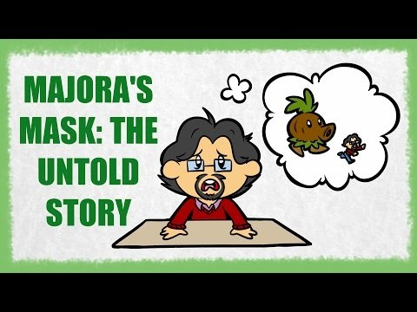

Slide 10
References
Games like “The Forgotten Song”
The Legend of Zelda: Majora’s Mask – Time Mechanic/Character Transition Mechanic
Stardew Valley – Schedule Mechanic/Cutscenes/Art Perspective
Undertale – Decision-based outcomes
Final Fantasy (Early Games) – Cutscenes/Immersive Story
To The Moon – NPC-centric gameplay/Story
Recommended
To The Moon – Available on Steam
Stardew Valley – Available on Steam

